Slide 1
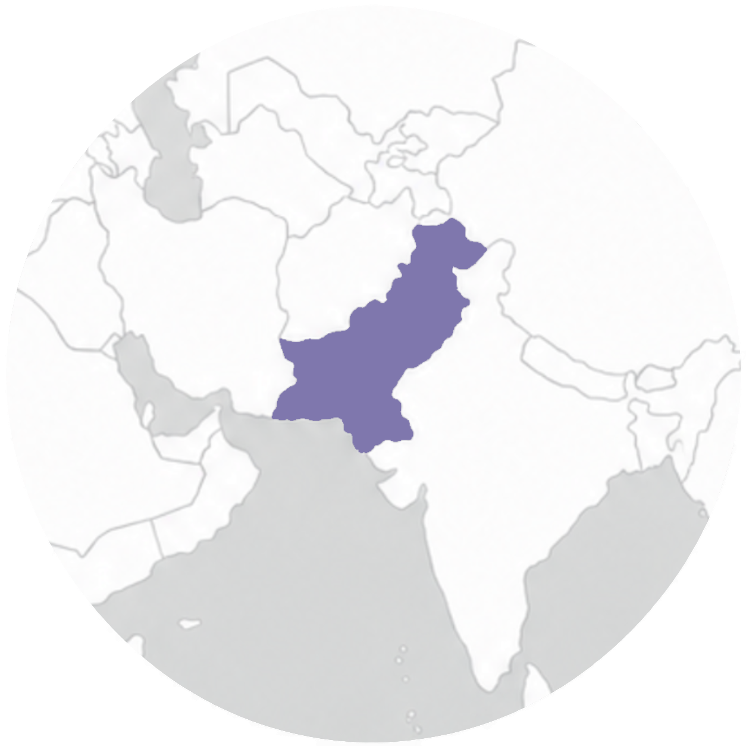
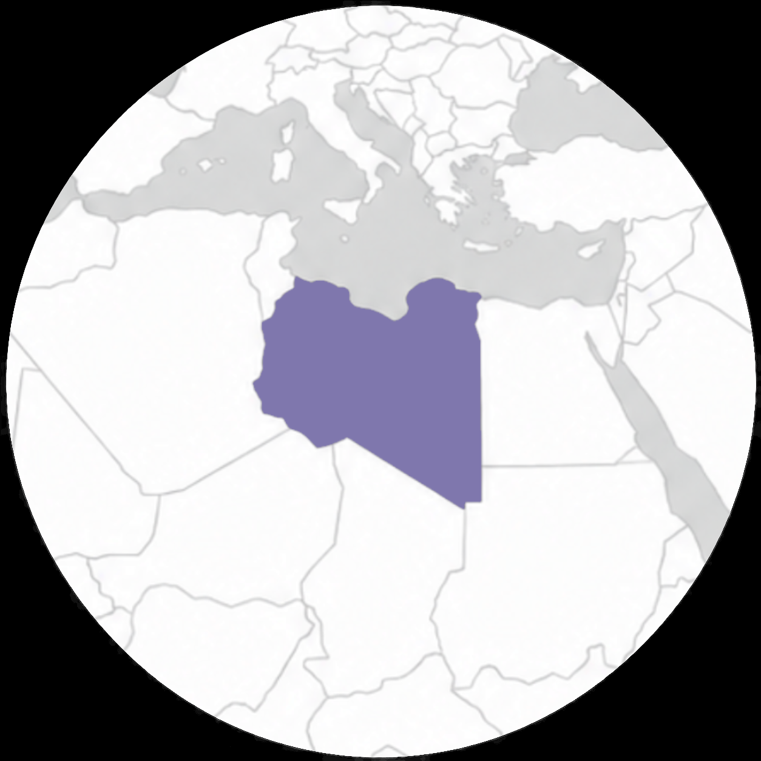

Pray for Libya
Protection for Christians and new believers
Healing for those affected by violence and loss
More Libyans to encounter Jesus
Peace, reconciliation, and national unity
Justice, religious freedom, and good governance
idop.org

Slide 2
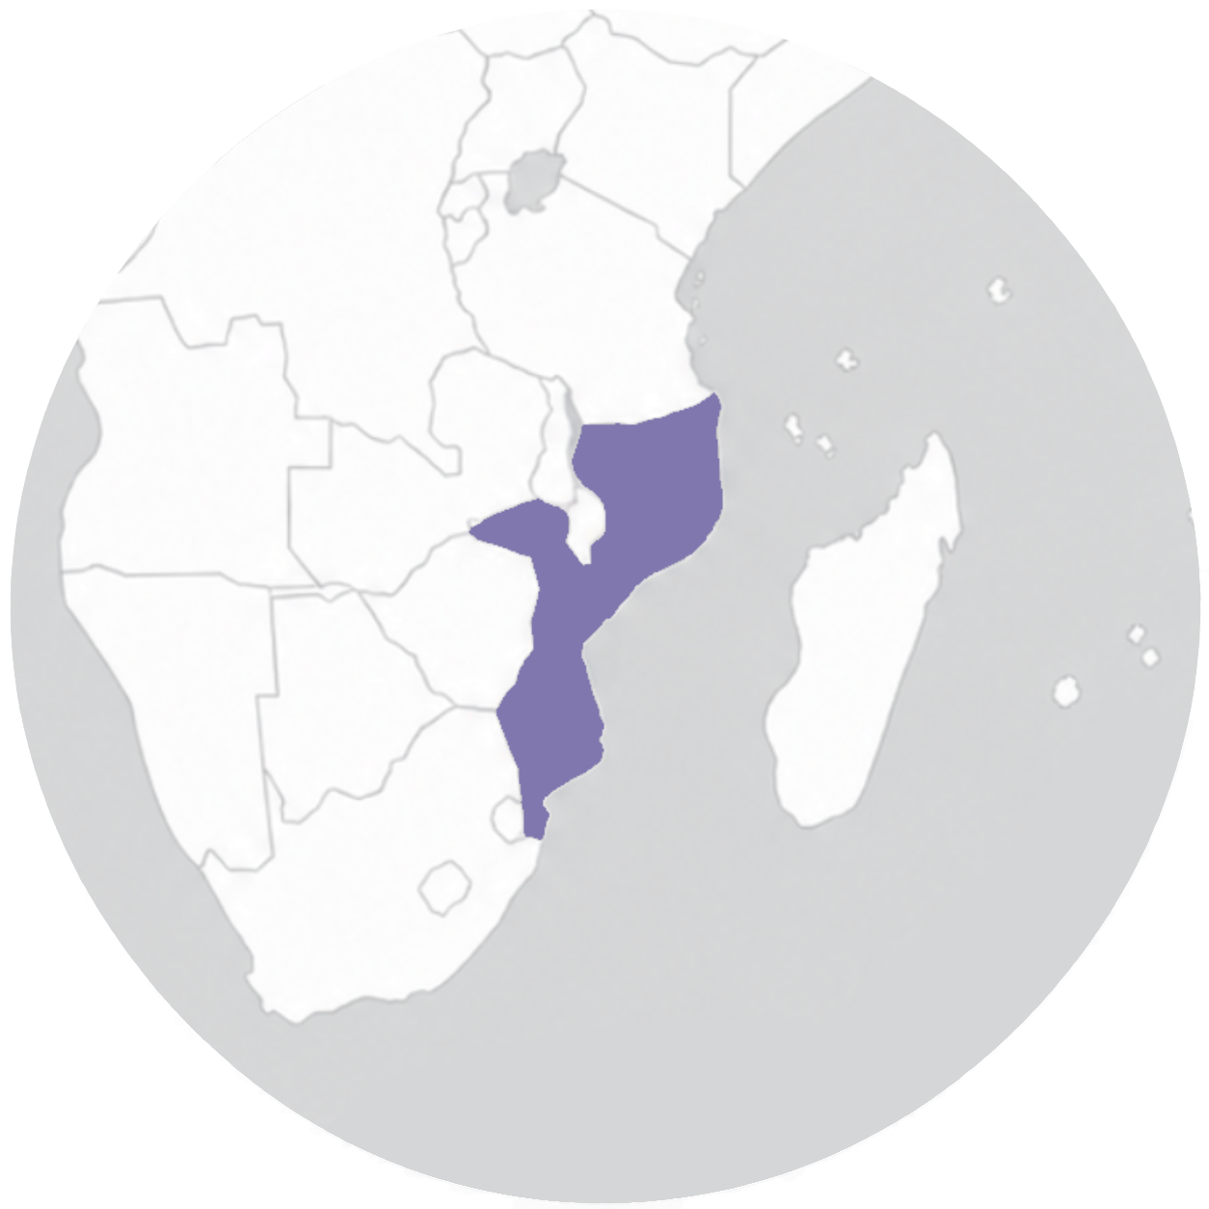
Pray for Mozambique
Protection for Christians facing violence, displacement, and insecurity
Healing for those affected by conflict
Courage for believers to share the gospel
Peace and stability in Mozambique
Wisdom and justice for government leaders
idop.org

Slide 3
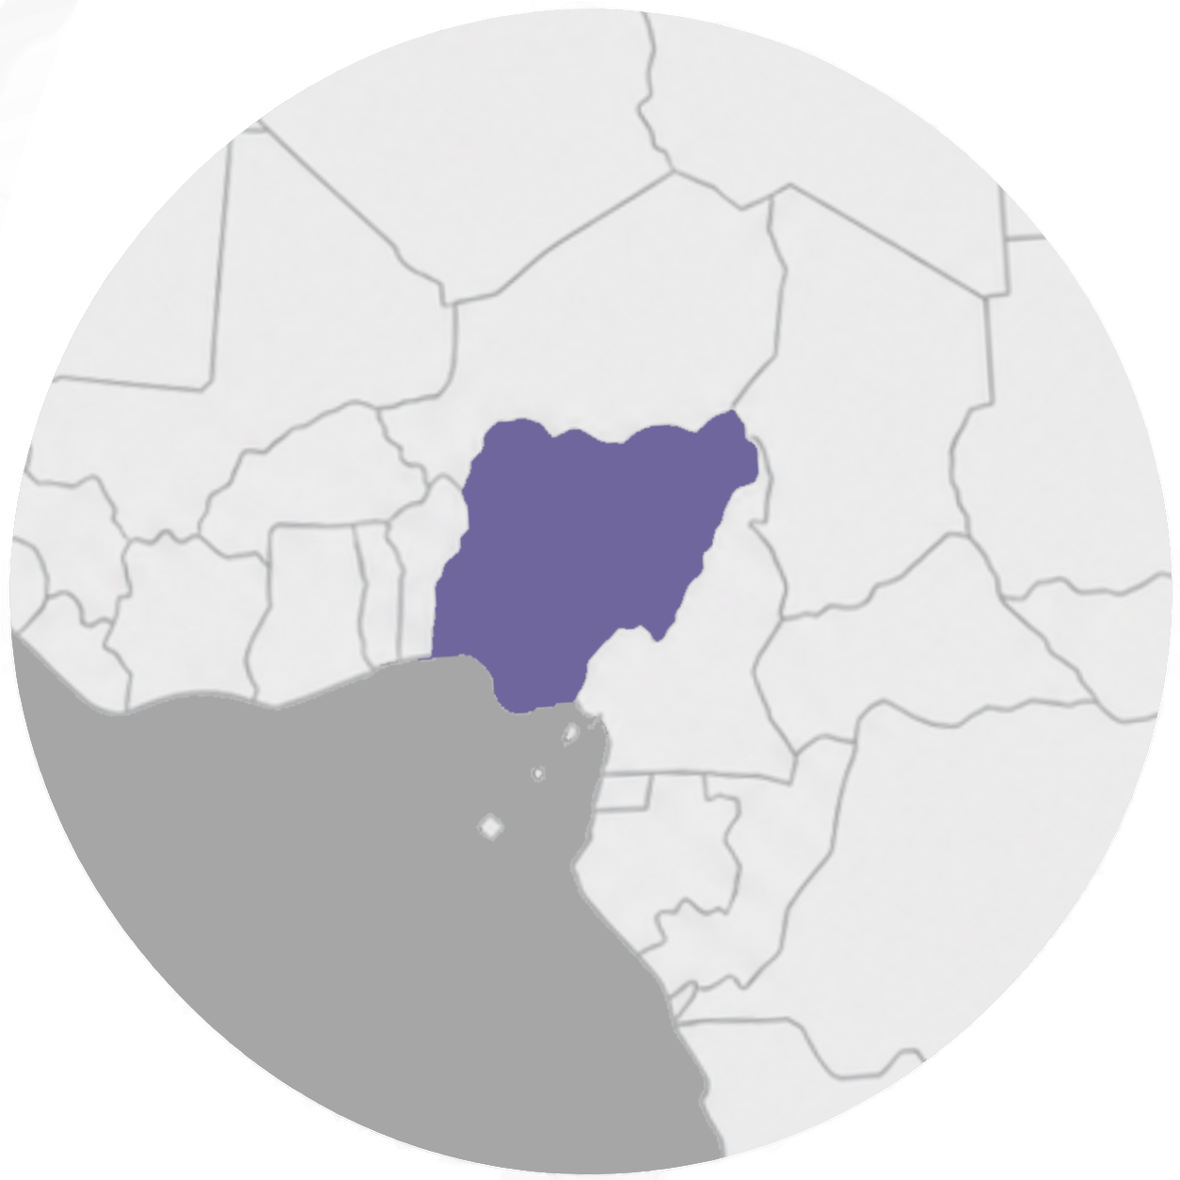
Pray for Nigeria
Protection and strength for Christians facing persecution
Comfort and healing for those affected by violence and loss
Freedom and safety for abducted and vulnerable children
Wisdom and justice for government leaders and security forces
Peace, reconciliation, and hope across Nigeria
idop.org

Slide 4
Pray for Pakistan
Protection for Christians facing discrimination, false accusations, and violence
Safety and freedom for Christian girls at risk of abduction, forced conversion, and exploitation
Hope, provision, and justice for Christian families living in poverty and bonded labour
Healing and strength for those affected by persecution, trauma, and loss
Courage for government leaders to protect religious minorities
idop.org

Slide 5
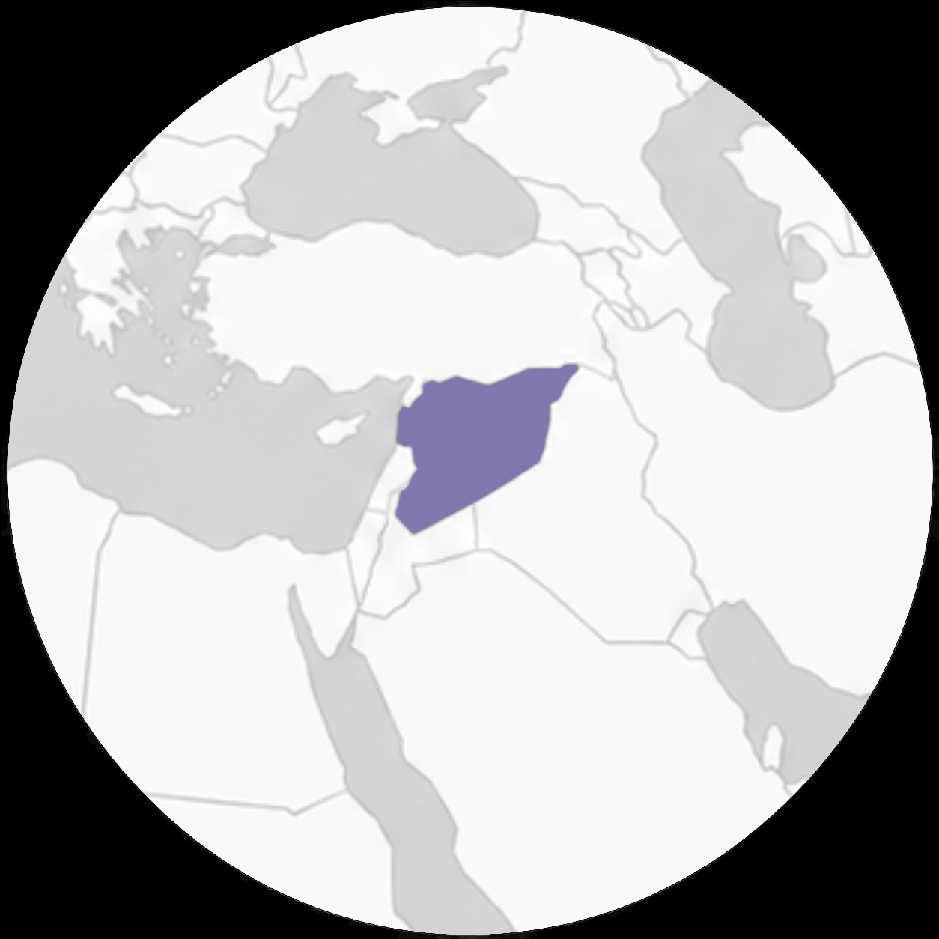
Pray for Syria
Strength, hope, and perseverance for Christians facing uncertainty and hardship
Healing and comfort for those who have suffered violence, loss, and displacement
Peace, justice, and reconciliation for Syria and its people
A growing movement to Christ among Kurds, Druze, and other Syrians
God's provision for those facing poverty and ongoing humanitarian needs
idop.org

